Slide 1

The bank management system
Presenters: Nabeel Ahmed
Shivam Gehani

Slide 2




Agenda
Introduction
Problem statement
Proposed Methodology
Types of Accounts
Major outcomes
Project timeline
conclusion

Slide 3



Introduction
Application to maintain persons account in bank.
To perform basic financial transaction in banking platform.
To perform different banking tasks in various ways
fund transferring
bill payments.

Slide 4
Problem statement
this online banking system is created to get rid of manual system and manage the banks record technically.
it is very difficult to update account data, insert new data, update data in manual system.
therefore we created it with automated database system to maintain all records and customers personal information technically.

Slide 5
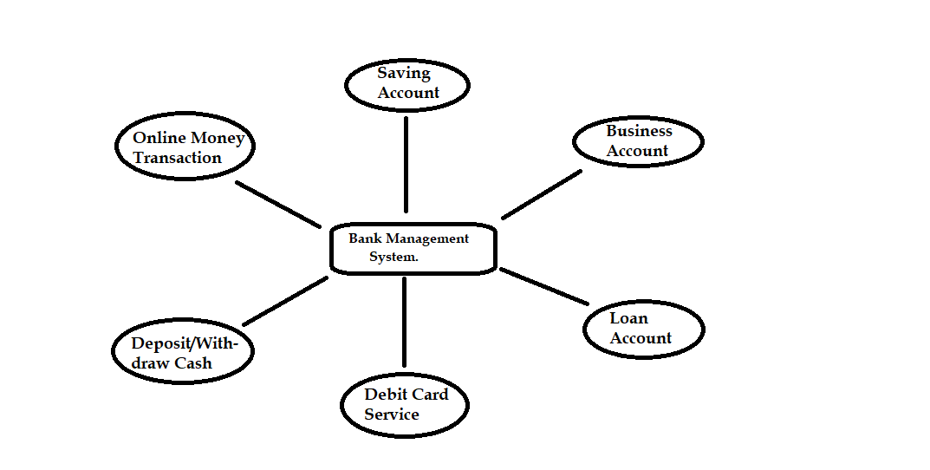
Types of Accounts

Slide 6
Timeline
20th Dec 2021
After that we will work on the second page that will display the online transactions
30th dec 2021
In this week we will work on the Other Settings that user can change the password of his/her Account.
15th Jan 2022
Now the final work is to Design the project to make it creative. There we will implement pictures, various types of fonts and colors.
10 Dec 2021
. We will create a frame in which we are going to implement a Login page for our Bank Management System. In that login page the user can login account and Register new account.
System to the customers.

Slide 7
Major outcomes
Maintain the automated database system which will assist to keep secure the customer’s data as well as it provide security to online transactions.
Privacy is an essential characteristic that may affect user intention to adopt online transaction system. Encryption technology is the most common feature of all banks.
Security plays greater role for the safety of customer’s financial and personal information

Slide 8
conclusion
We have created Banking Management System application for maintaining a person’s account in bank. This banking management system will help customers to perform basic financial transaction in banking platform. This application is created to facilitate the user to be on the track of online banking platform.
we have created this bank management system with automated database functionality in order to maintain the records of customers which is very essential to manage the documents and personal information of customers.

